Slide 1
Princethorpe Reading Recommendations
by Lockdown Book Club and Remote Reading Group

Slide 2
Highly Recommended
Book club favourites

Slide 3
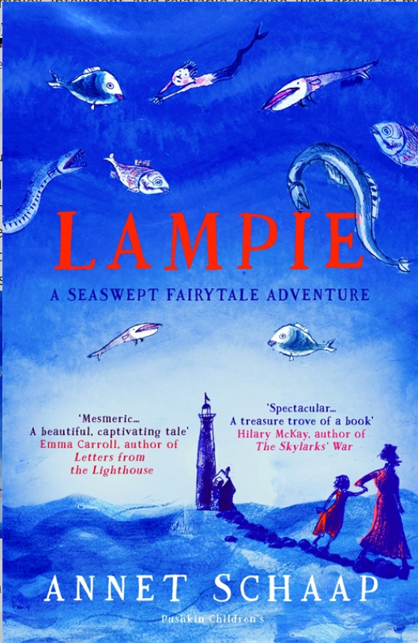
KS3
Lauren Mason
Lampie – Annet Schaap
A magical book. I enjoyed it because it was an exciting, fast paced fairy tale adventure. I would really recommend it to anyone who likes fantasy (mermaids and pirates coexist alongside normal life). There was a nice subtle message behind the story about the right to be different, and the importance of friendship and family. Interestingly this book has been translated - the original language was Dutch - but I think this just adds to the whimsical nature of the story.

Slide 4
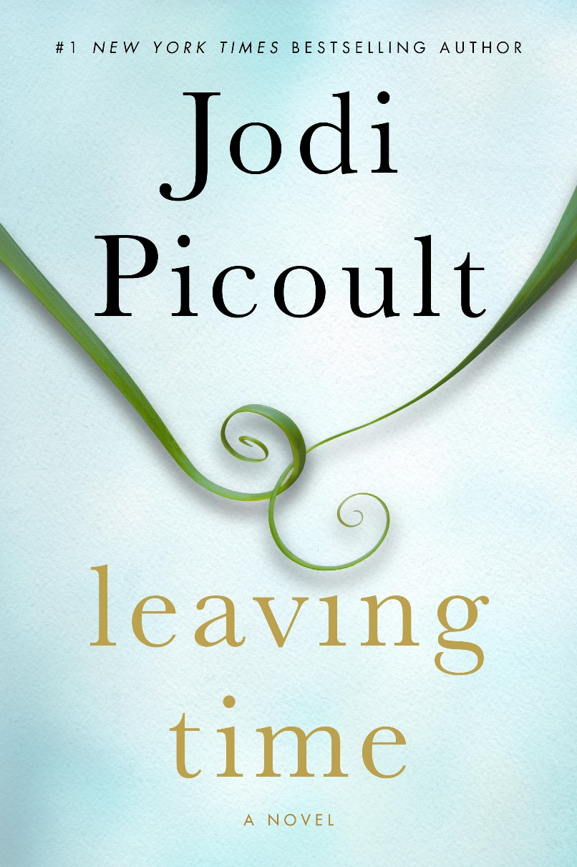
12+
Keira MacRae
Leaving time – Jodi Picoult
Leaving time by Jodi Picoult is really good. It’s about a young girl called Jenna who enlists the help of a psychic to try and find out what happened to her mother who went missing when she was younger. This is an extremely warm yet exciting narrative and is great for anyone who likes familial type stories. The whole book is narrated from a few different perspectives and times in the characters history which keeps you effectively engaged. This book is also great for those of you who like informative story books as there is a key focus on the study of elephants that runs throughout the novel. I learnt loads of super interesting facts about elephants reading this book and Jodi Picoult clearly did a lot of research which allows the story to blend with the information very well. There is a huge plot twist at the end though! I would definitely recommend this book as it had me utterly gripped and I couldn’t put it down. 😊

Slide 5
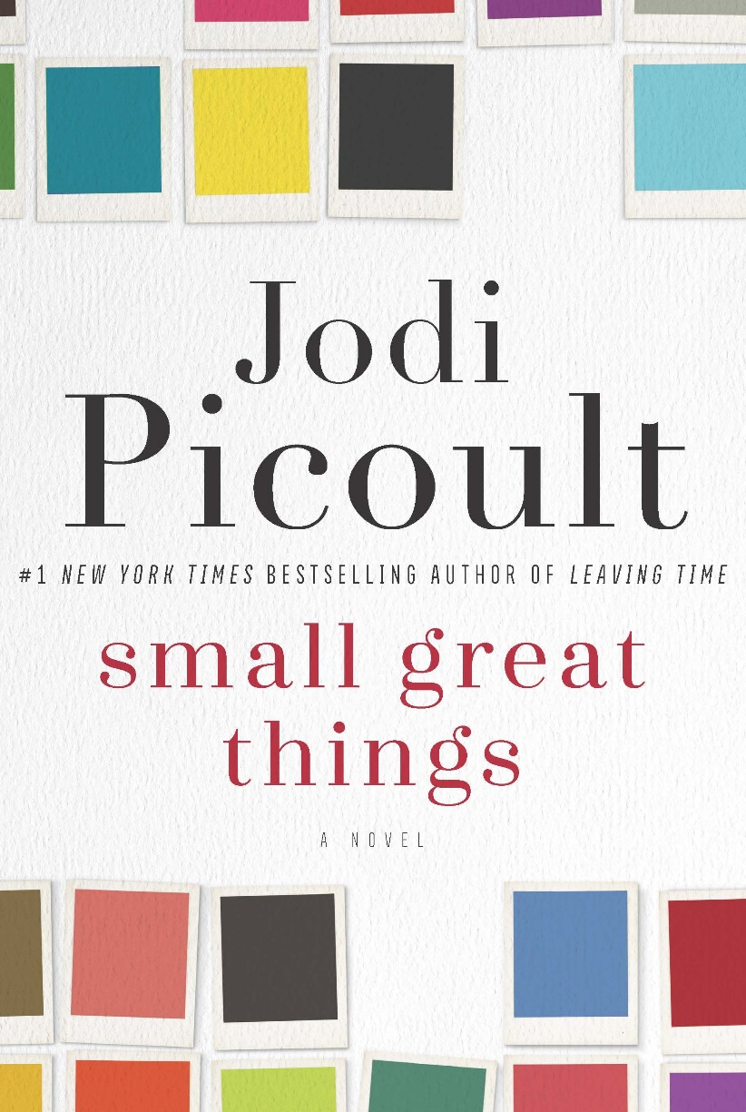
Keira MacRae
Small Great Things – Jodi Picoult
I wanted to include the book Small great things by Jodi Picoult as I feel not only is it an extremely powerful narrative, it is also very current. This book tells the story of a black midwife who delivers the baby of a white supremist couple. However, when the baby dies of complications linked to its genetics, the couple immediately blame the nurse and launch a court case against her. This book explores deep into not only the deep-set systemic racism present in America’s society, but also the radical extremes of racism and how the two compare. Picoult looks at the story again, from a few perspectives which allows the audience to get a closer look at each character’s emotions and motives. This is a brilliant and gripping book which deals with so many prevalent problems in todays society. And in a time like this where it is more important than ever to educate yourself on issues like this, I would urge you to give this a read.
14+

Slide 6
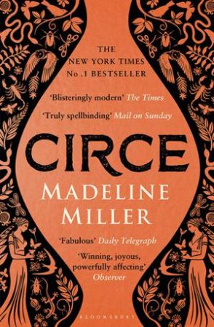
Year 9+
Lauren Mason
Circe – Madeline Miller
An intricate and beautifully written retelling of the life of Circe, an immortal but inferior goddess/witch from Greek mythology, and her exile on the island of Aiaia. The character of Circe is what brings this book together - she is a complex, intelligent, and relatable heroine, who grows so much throughout the story as various characters come her way. The excellent conclusion took me by surprise but is a great fit for the story.

Slide 7
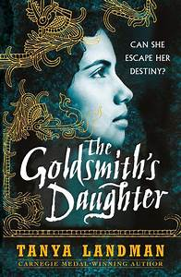
Charlotte Fitzpatrick
The Goldsmith’s Daughter – Tanya Landman
This book is written from the point of view of a girl living in the Aztec city of Tenochtitlán, where women were expected to fulfill the role of being a cook and seamstress for their husbands. The Goldsmith’s Daughter completely immerses you in Aztec culture and allows you an insight into what it was like to be a woman at this time. The main character, Itacate, feels like a real person to me, fully formed in my mind. She is skilled in the patriarchal art of being a Goldsmith, creating beautiful sculptures, however she has to hide her talent in order to stay alive. This book is beautifully written by Tanya Landman, who I view as one of the most wonderful authors of our time. Her ability to bring readers back to different periods of time is simply magical and I would recommend any of her books to anyone.
The one bad thing I have to say about it, is that the ending was slightly rushed – but otherwise it was action-packed and thrilling to read!
Year 8+

Slide 8
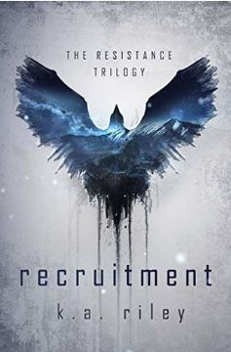
Recruitment – K.A. Riley
A dystopian. First in the Resistance trilogy.
In the Valta, no matter what month you were born, everyone is assigned the same birthday. November 1st. It's the anniversary of the day when the government declared war on the Eastern Order. The day you turn seventeen, the Recruiters come to take you away. And no one ever hears from you again. It’s October 31st. Today, Kress is sixteen years old. Tomorrow, she’ll be taken. The good news? So will her best friend Cardyn, and Brohn, the handsome, enigmatic boy she’s avoided all her life. The bad news? Recruitment isn’t what any of them expected. Weeks of training await. Military and psychological tests, escape rooms, hand-to-hand combat. The Recruits are told they're the key to winning the war. But with each day that passes, things begin to make less sense. If only Kress had been able to bring her trained raven, Render, with her. If only none of them had ever had to come to this place.
Year 9+

Slide 9
Series
Get stuck into these for the long haul over the summer!

Slide 10
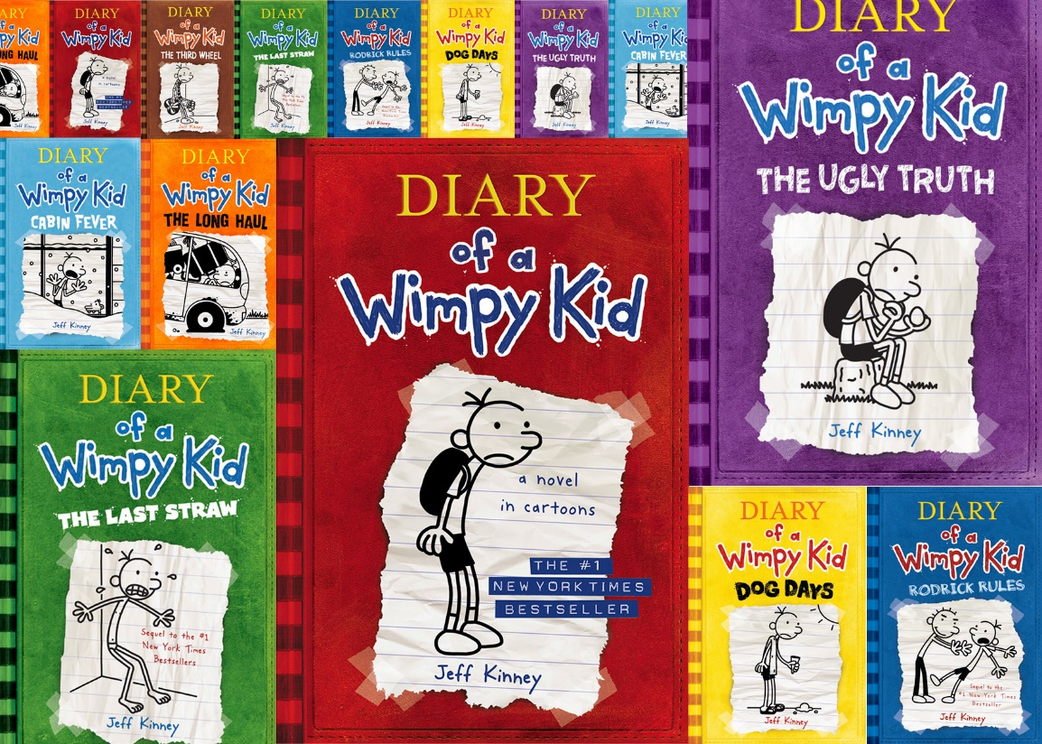
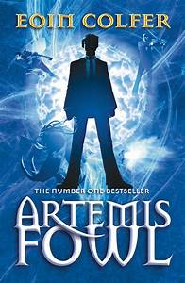
Diary of a Wimpy Kid – Jeff Kinney
Hilarious, easy to read, and perfect for the summer holidays! About a boy called Greg who fills in a journal of all the misadventures in his life.
Artemis Fowl – Eoin Colfer
A fast paced and funny book about a teenage criminal genius who discovers a hidden world of hi-tech fairies living underground. Film now out on Disney+
KS3
Stormbreaker – Anthony Horowitz
The first of the Alex Rider series – follows a teen who is recruited by the secret services. Action packed. TV series now available on Amazon Prime, read books 1 and 2 first!

Slide 11
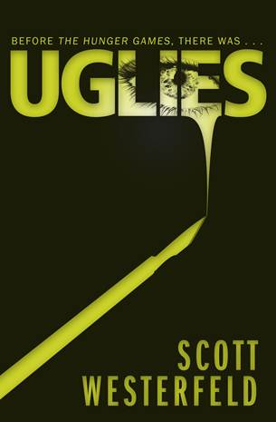
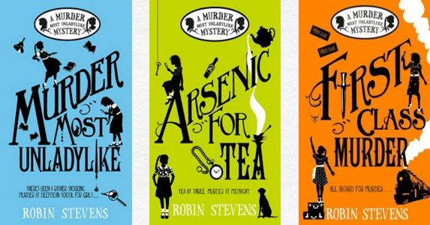
Year 8+
Bridget Jones’ Diary – Helen Fielding
Loosely based on Pride and Prejudice but much more of a romantic comedy for the modern era. Funny and observant.
Murder Most Unladylike – Robin Stevens
Murder mystery in the setting of a 1930s girls boarding school. Two girls take it upon themselves to form a detective agency and solve the case.
Year 10+
KS3
Uglies – Scott Westerfeld
Good for fans of The Hunger Games and Divergent (controlling government regimes!). Set in a dystopian world in which everyone is considered an “ugly”, but then turned “pretty” by extreme cosmetic surgery at age 16.

Slide 12
Verse novels
Books written in poetry form are becoming more popular due to their ability to convey so much meaning in so few words, and so little time. Brilliant authors who write in this style include Kwame Alexander and Sarah Crossan.

Slide 13
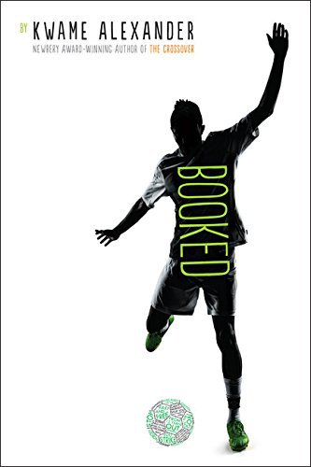
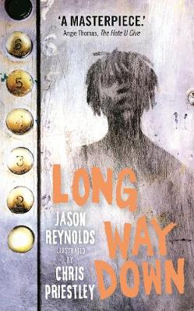
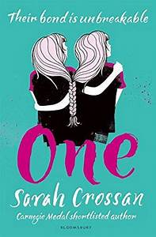
Booked – Kwame Alexander
A book about family, love, friendship, and football, following the life of 12-year-old Nick as he wrestles with the problems life throws at him.
Long Way Down – Jason Reynolds
Takes place over a period of 60 seconds – the time it takes a teenager to decide whether or not he’s going to murder the guy who killed his brother. Terrifying, thought-provoking, and unputdownable.
Year 7+
Year 9+
One – Sarah Crossan
A poignant, raw, and admirable story about two 16-year-old conjoined twins, Grace and Tippi, who go to school for the first time, when their family can no longer afford the homeschooling. Will make you cry.
Year 8+
The Poet X – Elizabeth Acevedo
Coming-of-age story. An account of 15-year-old slam poet, Xiomara’s experience of growing up in her Harlem neighbourhood. Tackles multiple important topics such as family, religion, and racism.

Slide 14
Non-fiction
Reading can really help you learn more about the world we live in.

Slide 15
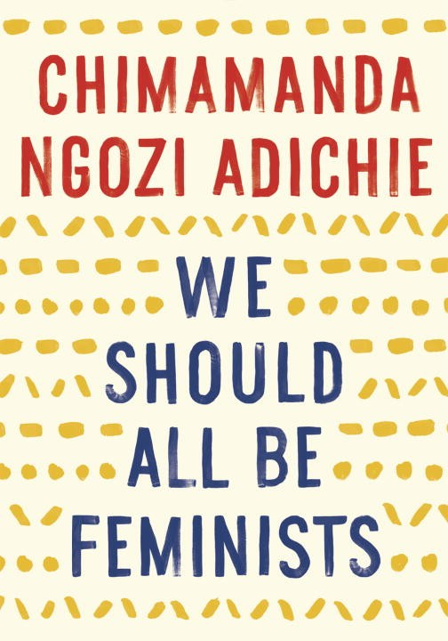
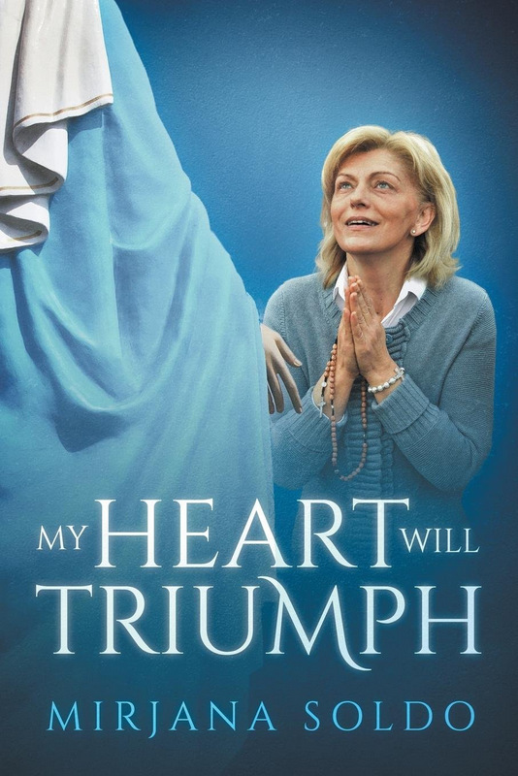
We Should All Be Feminists – Chimamanda Ngozi Adichie
Personal, witty and eloquently argued essay exploring what it means to be a woman today and why we should all be feminists.
Why I’m no longer talking to white people about race – Reni Eddo-Lodge
Written by an award-winning journalist. Offers a new framework for how to see, acknowledge, and counter racism. An exploration of what it is to be a person of colour in the UK today.
My Heart Will Triumph – Mirijana Soldo
Autobiography. Having experienced apparitions of the Virgin Mary for over 35 years, the author, Mirijana, has decided to share her story with the world.

Slide 16
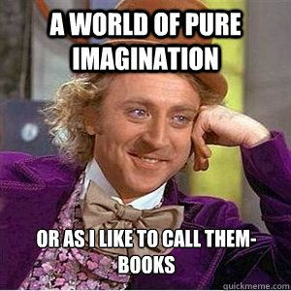
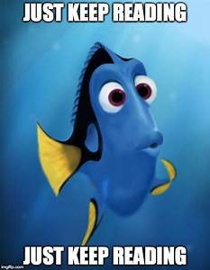
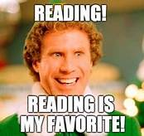
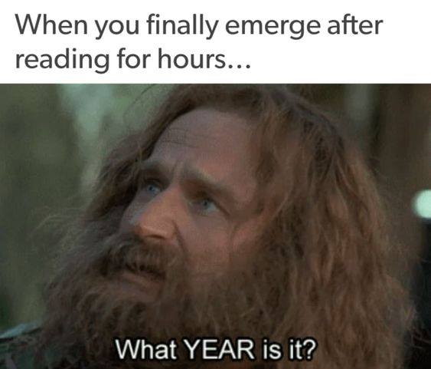
Have a great summer everyone ☺

